Slide 1

From MLPs to CNNs for images
Sarina & Nick

Slide 2
Multi-Layer Perceptrons
Has an input layer, output layer, and at least one hidden layer
Require a one dimensional input vector
Every neuron connects to every neuron in the following layer
The Multilayer Perceptron (MLP) procedure produces a predictive model for one or more dependent (target) variables based on values of the predictor variables (ibm, n.d)

Slide 3
Convolutional Neural Networks
Operation used to scan an image with a small filter/kernel.
made from artificial neurons that learn weights
many layers of these computations connected together
Convolutional Neural Networks (CNNs) are unique neural networks for image recognition and computer vision (ibm, n.d)

Slide 4

Convolution Layer

Slide 5
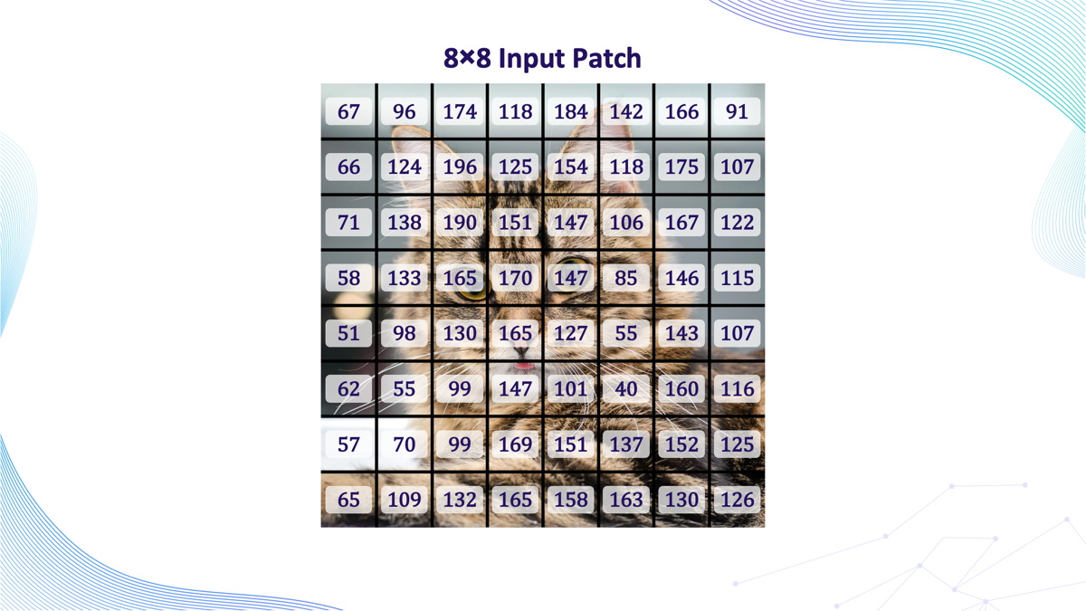
Notes:
Detects by brightness

Slide 6
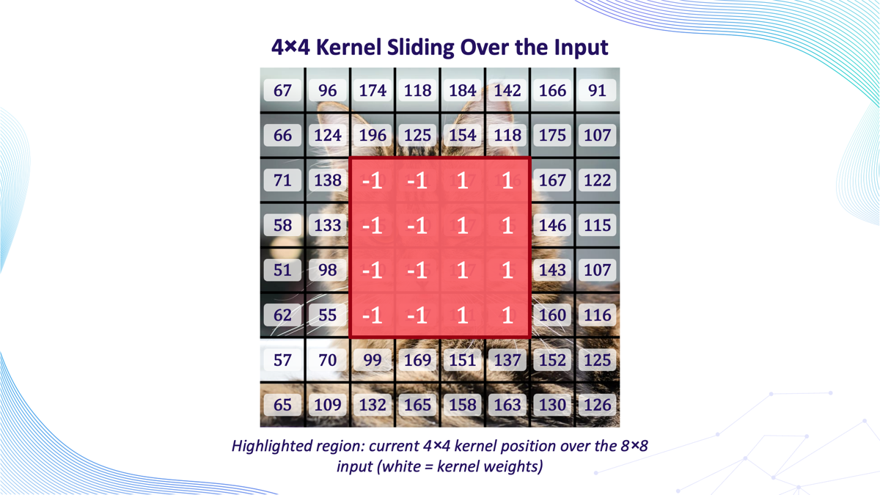
Notes:
The kernel we used is a vertical edge detector
It compares the average brightness on the left side of the kernal to the average brightness on the right side. If there's a big brightness difference between left and right — like where the cat's darker fur meets a lighter background — the kernel produces a large output (positive or negative). If the left and right sides are similar in brightness, the output is close to zero.

Slide 7
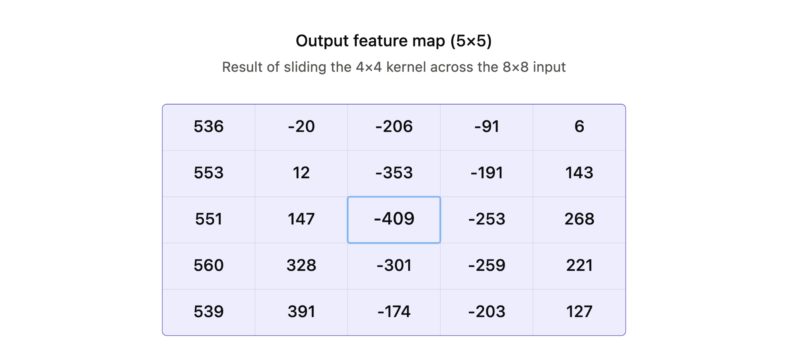
Notes:
Reuse the kernel over the whole image and get a feature map, so once it learns to recognize something in one place, it can spot it anywhere in the image
The left column (j=1) is strongly positive across every row (~536–560) — makes sense, since that column of the sliding window sits over the transition from background into the cat's face, where the left side of the patch is consistently brighter than the right.
The middle column (j=3) is strongly negative — that's the region centered right on the cat's eyes/nose area, where the pattern reverses.

Slide 8
Activation Layer
Pooling Layer
Fully Connected Layer
-100
442
-100
442
232
291
232
291
442
283
331
407
364
319
Notes:
Activation Layer (ReLU)-> After each convolution, ReLU passes positive values through and zeroes out anything negative
Pooling Layer-> Shrinks each feature map by summarizing small regions (e.g. 2×2) into a single value (max pooling keeps the strongest signal)
Fully Connected Layer-> Feature maps get flattened into one long list, then fed through a dense layer that combines everything to start making a decision.

Slide 9
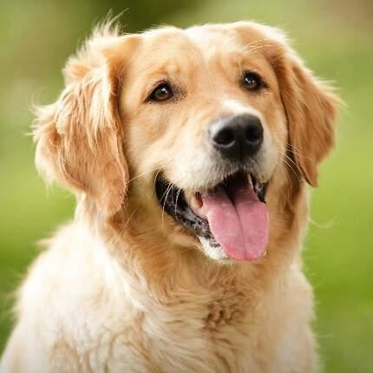
Classifier (Softmax)
Cat
Dog
Probability: 92%
Probability: 26%
442
283
331
407
364
319
Notes:
The final layer turns the fully connected output into a probability for each class
Softmax makes sure all the probabilities add up to 100%
Highest probability = the network’s prediction (e.g. “cat”)

Slide 10
Putting It All Together
Early on in convolutions, the network notices simple things (edges, lines, corners)
Those get combined into slightly more complex shapes (curves, textures)
Eventually those combine into recognizable objects (eyes, a wheel, a face)
Flattening happens at the end then classification.

